Slide 1
House Pricing Data
Group 6

Slide 2
Problem Statement
We have been provided with data of districts in state of California with median house prices; our objective is to predict median house prices basis the data available.
Independent Variables
Dependent Variables
longitude
latitude
housing_median_age
total_rooms
total_bedrooms
population
households
median_income
ocean_proximity
median_house_pricing

Slide 3
Data Pipeline
Scaling X
Base Model
Grid Search
Result Comparison
&
Selection
of
Best Model
Raw Data
Clean Data
Train/ Test Split
Scaling X,Y
Fill Missing Values
Remove Max of Y Var
No Scaling
Reading/ Cleaning
Preparing
Modeling/ Evaluation

Slide 4
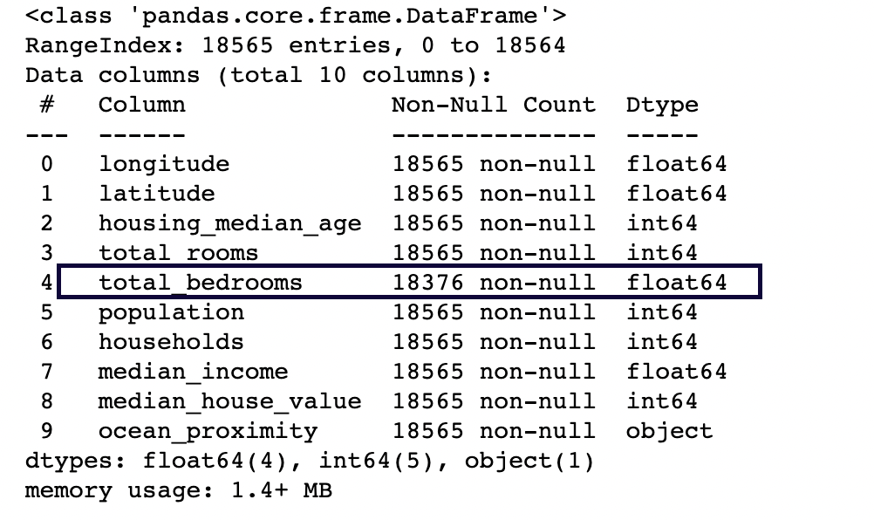
Reading the data
Column Name | Possible Description | Data Type
longitude | longitude of location | numeric
latitude | latitude of location | numeric
housing_median_age | median age of a houses in a locality | numeric
total_rooms | total rooms in a locality | numeric
total_bedrooms | total bedrooms in a locality | numeric
population | number of people residing in locality | numeric
households | number of group of people residing within a home unit | numeric
median_income | median income for households in (10,000 USD) | numeric
medain_house_value | median house value in a locality (USD) | numeric
ocean_proximity | proximity to ocean location | alphanumeric
Total bedrooms is one column with null values
Method to impute missing value:
Total bedrooms should be proportional to total_rooms
Total bedrooms should be proportional to number of house holds

Slide 5
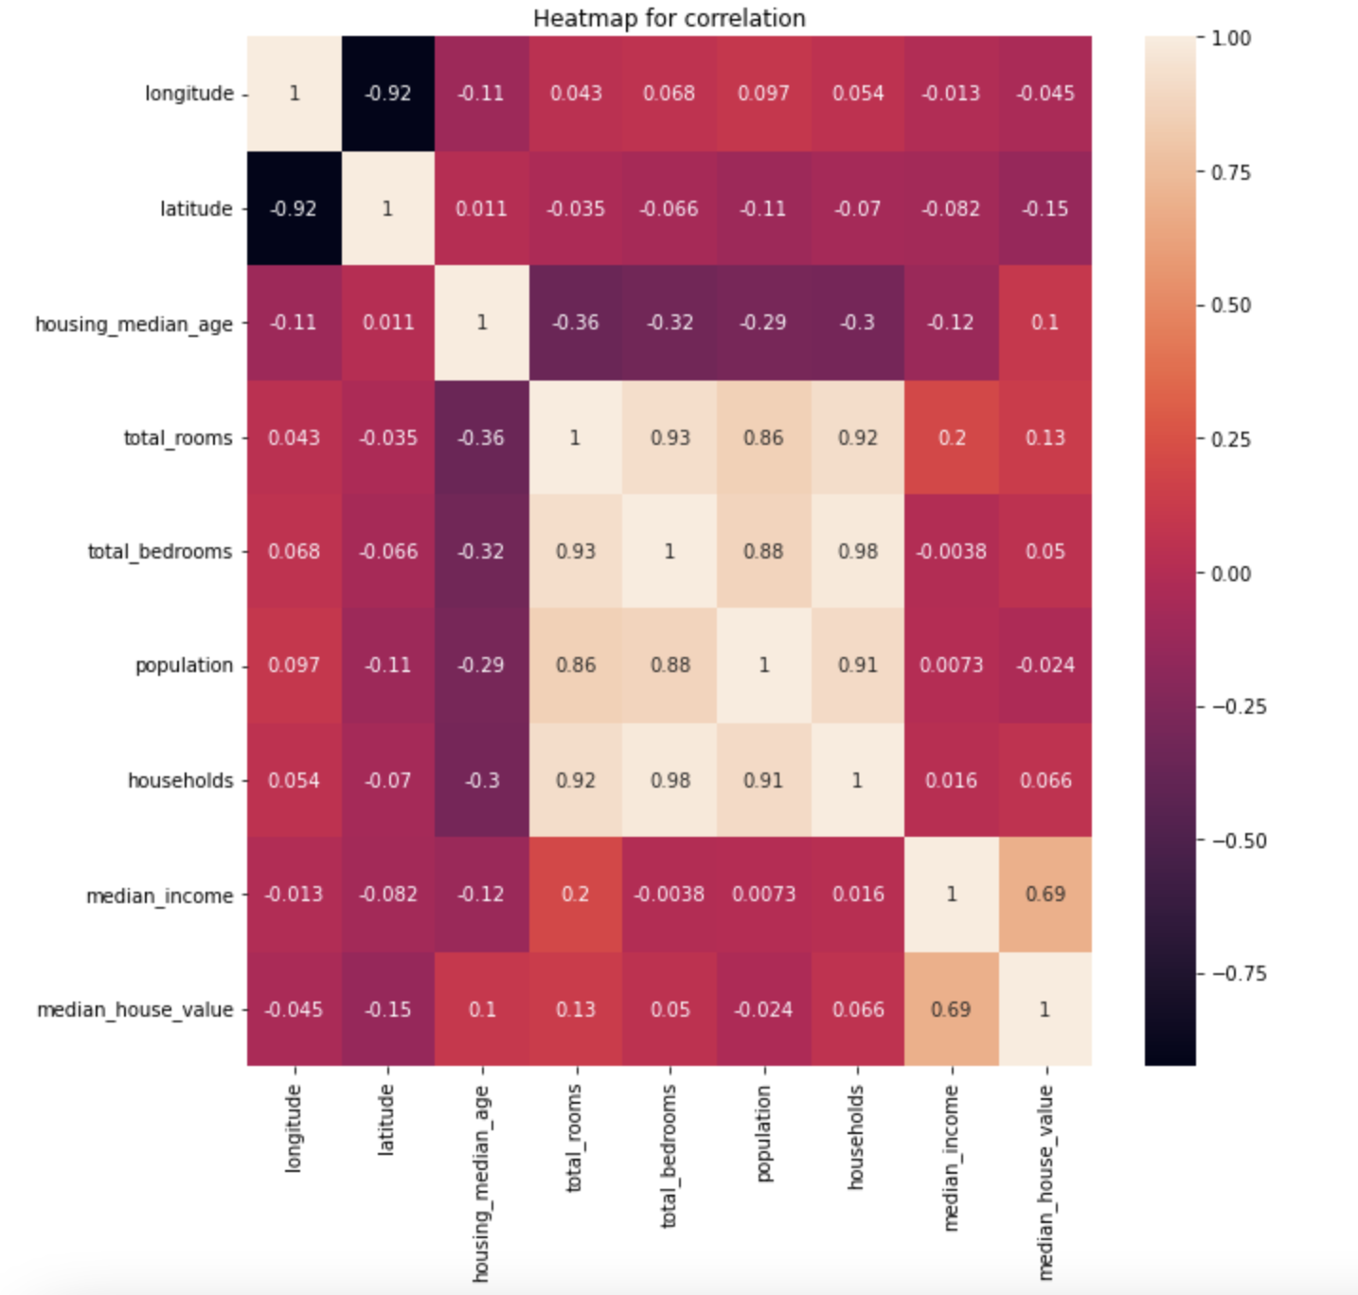
Correlation graph
Highly Correlated Variables are:
Households, total_bedrooms, population, total_rooms
Latitude and Longitudes
Housing Median Age with – Total Rooms, total_bedrooms, Population & Households
1. Population determines #Households which determines #rooms and #Bedrooms
2. Latitude Longitude will be correlated as from same area (California)
3. Median Age => Older areas => Larger houses => Lower population and Lower Number of rooms/ bedrooms etc.
Other reason can be older areas might have lesser amenities leading to lower population
We will use total_households to impute #of bedrooms: (Corr = 0.98)
Total_bedrooms (missing) = Households (Missing) * (mean)[Total_bedrooms/ Households]

Slide 6
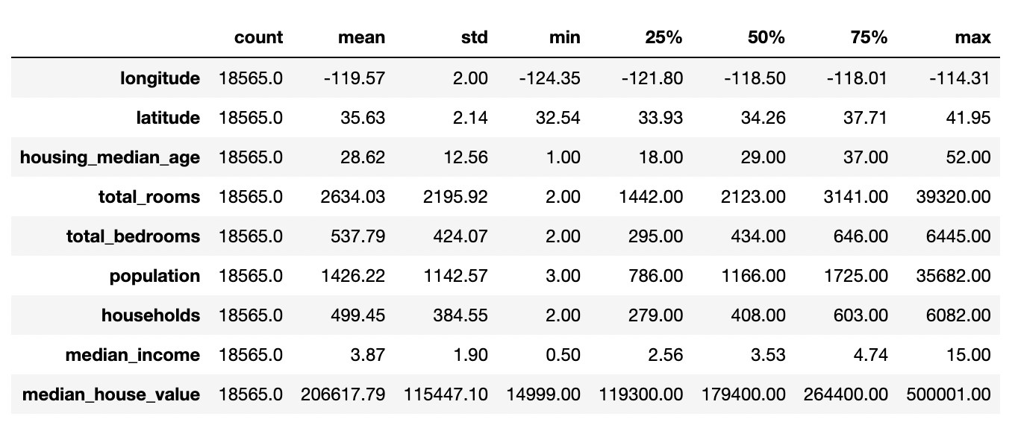
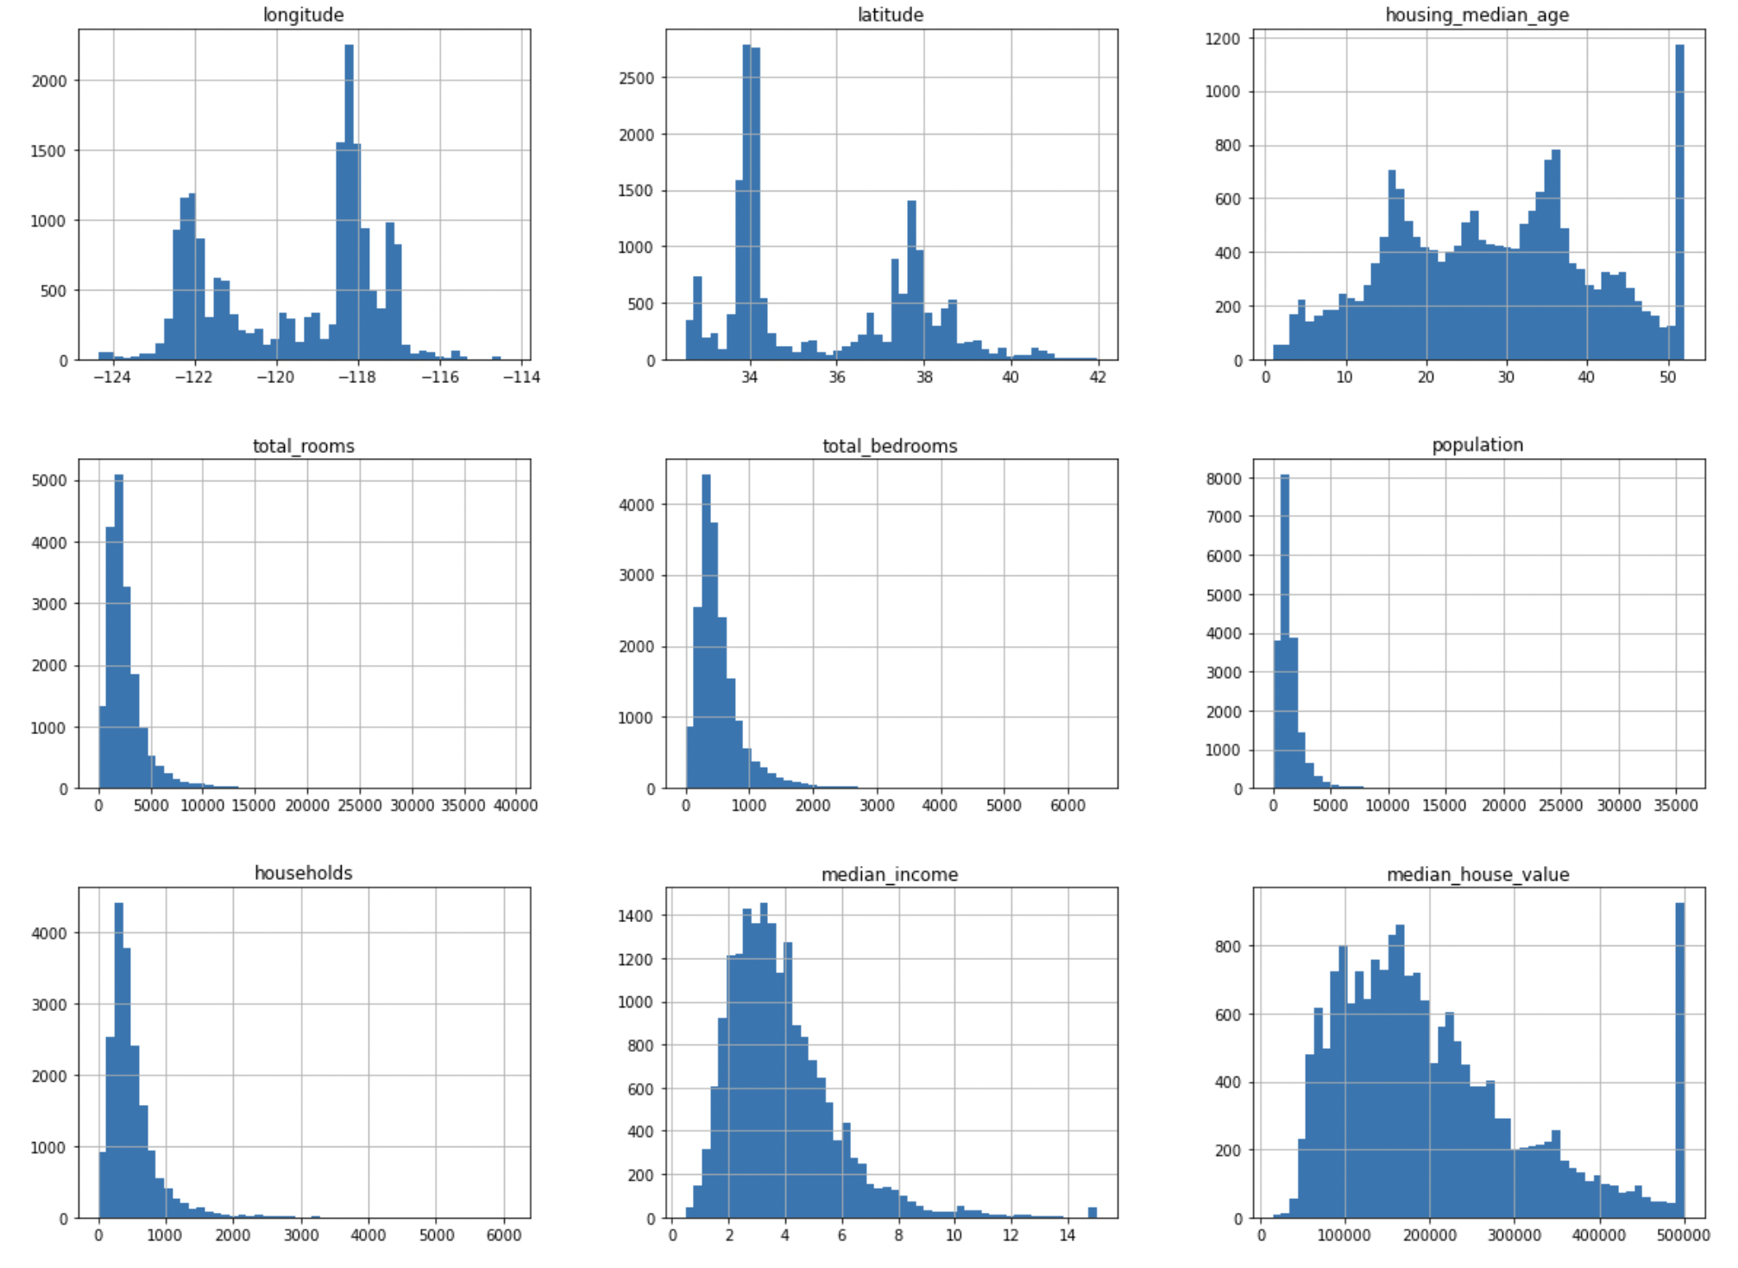
EDA of the data columns (1/2)
Median_House_Value being continues and having a cap of 500,001 leads to a dirty model and we would ideally like to remove this
There seems to be a capping on maximum values for Medain_House_Value and Housing_Median_Age;
Housing_Median_Age seems to be a discreet value therefore we can live with the maximum value of 52 (1,129 records)
4% Loss

Slide 7
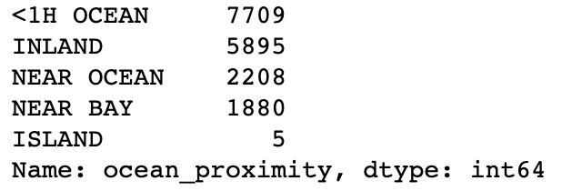
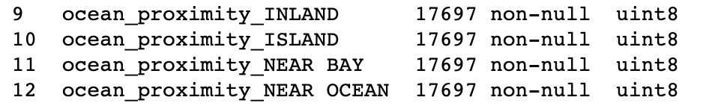
EDA of data columns (2/2)
Treatment of Categorical Variables
Standardization of the Variables
As the scale of variables is different, we need to standardize the variables to have the same mean. We would need standardization for following models:
Linear Regression – OLS; Lasso and Ridge
Neural Network
KNN Regression
Support Vector Regression (Requires scaling of the Y Variables as well)
We would not do the standardizations for the following set of models:
Decision Trees
Random Forest
Gradient Boosting

Slide 8
Regression Model (1/2)
Checklist for a Regression Model
No missing Values
Variables to be standardized
Split in Test and Train Set
Dependent and Independent variables are normally distributed
Non-existence of Multicollinearity in independent variables
We can ignore this for real-life models
To be treated basis the VIF Factors
Steps for Linear Regression
Running the Model
Testing the Model
Split the data into Train Test
Standardize Test/ Train data separately
Add constant using sm.add_constant
Run OLS (Ordinary Least Square) model using sm.OLS
Identify any variable having p-value > 0.05 and remove them from the analysis
Re-run the model
Remove Multi-collinearity via VIF Factors
Test for normality of residuals (P-P Plot)
Residual plot for homoscedasticity
Measuring R-Squared
Check for the difference between RMSE of Test and Train Data Sets
Check for R2 of Test Dataset

Slide 9
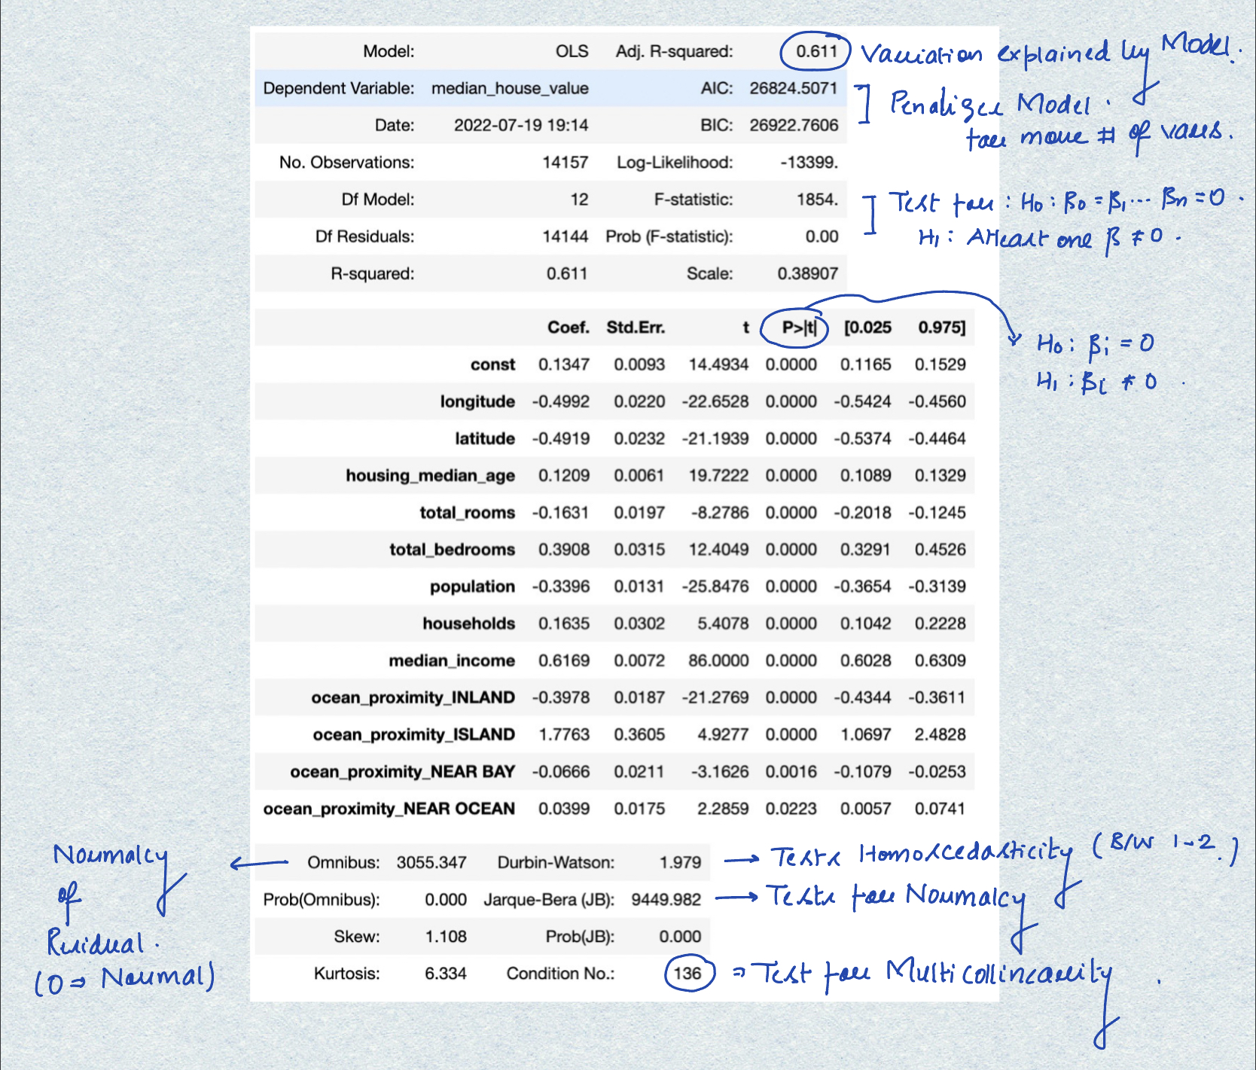
Regression model (2/2)
Analysis of the Model
Parameter | Meaning | Model Value | Ideal Value
Adj. R-Square | What % of dependent variable is explained by independent variables | 0.611 | 1.00
AIC/ BIC | Compares efficacy of the model | ~26K | As low as possible
Prob (F-statistics) | To check if all coefficients are 0 or not | 0 | 0
P > |t| | To check if individual coefficients are Zero | < 0.05 for all variables | < 0.05 for all variables
Durbin-Watson | To check for Homoscedasticity | 1.979 | Between 1 and 2
Omnibus | Describes distribution of Residuals (if it is normal or not) | 0 | ~3k
P(Omnibus) | Null hypothesis that errors are normally distributed | 0 | Close to 1
J-B Test | Testing for errors being normally distributed | 9449 | Very Low
Condition Number | Tests for multicollinearity | 136 | Should be < 1000
Normality assumption can be departed away from in normal cases
We will test the multi-collinearity via VIF test

Slide 10
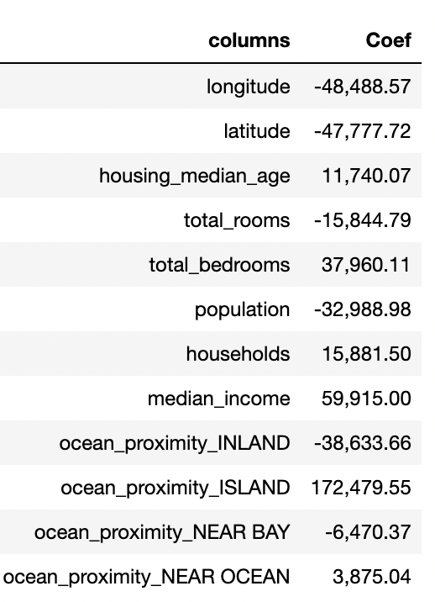
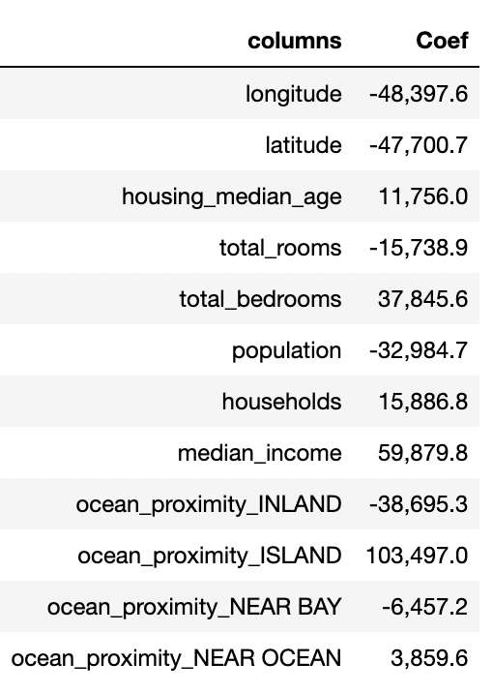
Regularized Regression
Lasso Regression
Ridge Regression
OUTCOME:
Ridge Regression performs at par with OLS
Performance of Lasso is worse amongst all the models
Lasso Removes non-correlated columns (ocean proximity...)
Amongst linear regression OLS/ Ridge is the best model
0.00
Reason multi-collinearity is acceptable in the model mainly on account of these variables may have a correlated relationship. However, independently contributing to the model.
Example: BMI = Kg/m2 where both weight and height have a relationship, but predicting BMI with one alone is not accurate
0.00
Parameter | Value
R-2 on Train Data set | 0.5016
R-2 on Test Data set | 0.5836
Parameter | Value
R-2 on Train Data set | 0.6112
R-2 on Test Data set | 0.6198

Slide 11
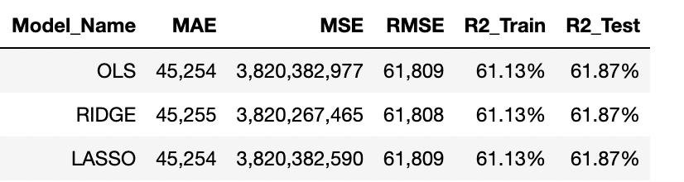
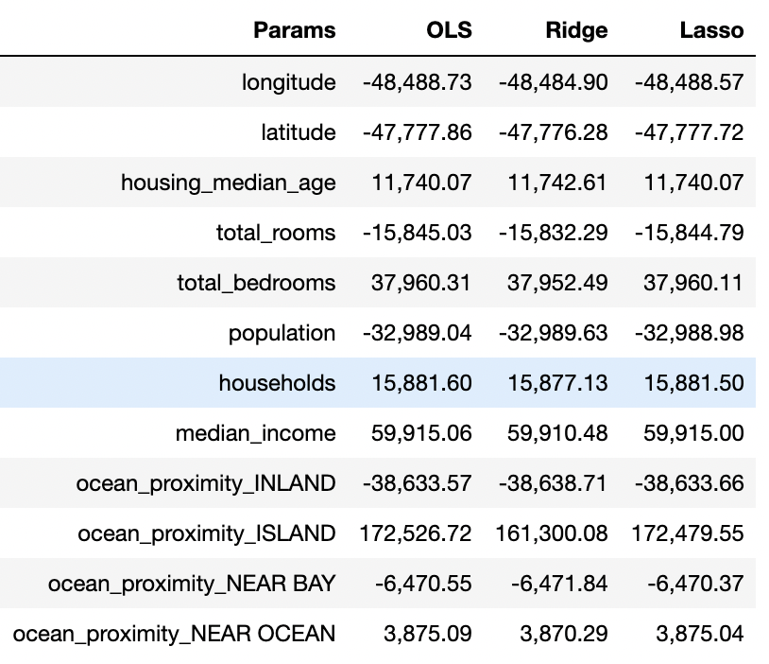
Comparison of Gridsearch Results of Regression
OUTCOME:
Gridsearch gives parameters for Lasso/ Ridge in such a way that model is very similar to OLS
There is no significant difference between 3 models, and anyone can be used

Slide 12
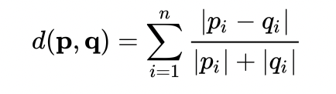
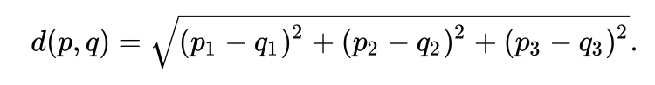
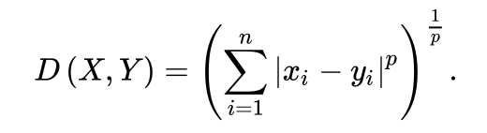
KNN Regression
Distance Metrics
Running K-NN Model
Canberra Distance
Parameters for K-NN:
n_neighbors – defining the number of nearest points for regression
metric - what kind of distance metric to choose the nearest points
Euclidian Distance
Grid-search
Minkowski Distance
We will use grid-search to find out the best parameters for the model.
Parameters for the best model are:
n_neighbors = 9
Metric = euclidean
Parameter | Value
R-2 on Train Data set | 0.7513
R-2 on Test Data set | 0.6858
Test and Train results both are better
Note: While the train results pre-gridsearch may be better post-gridsearch. However, due to cross validation the test results will be better

Slide 13
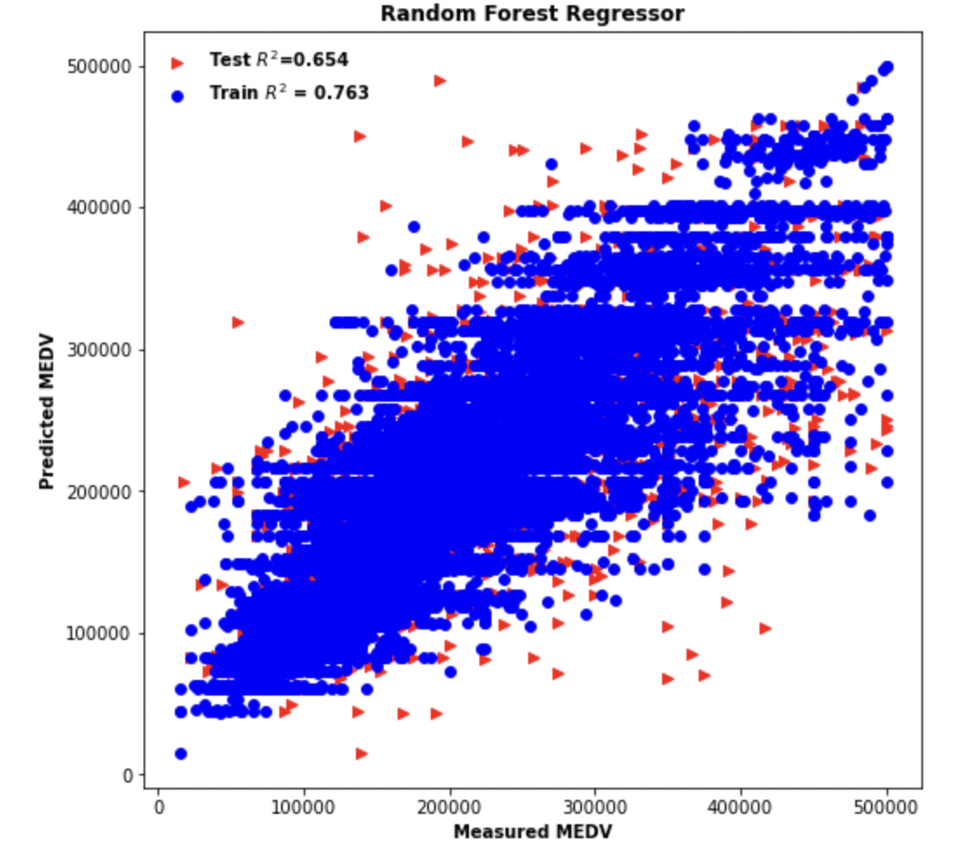
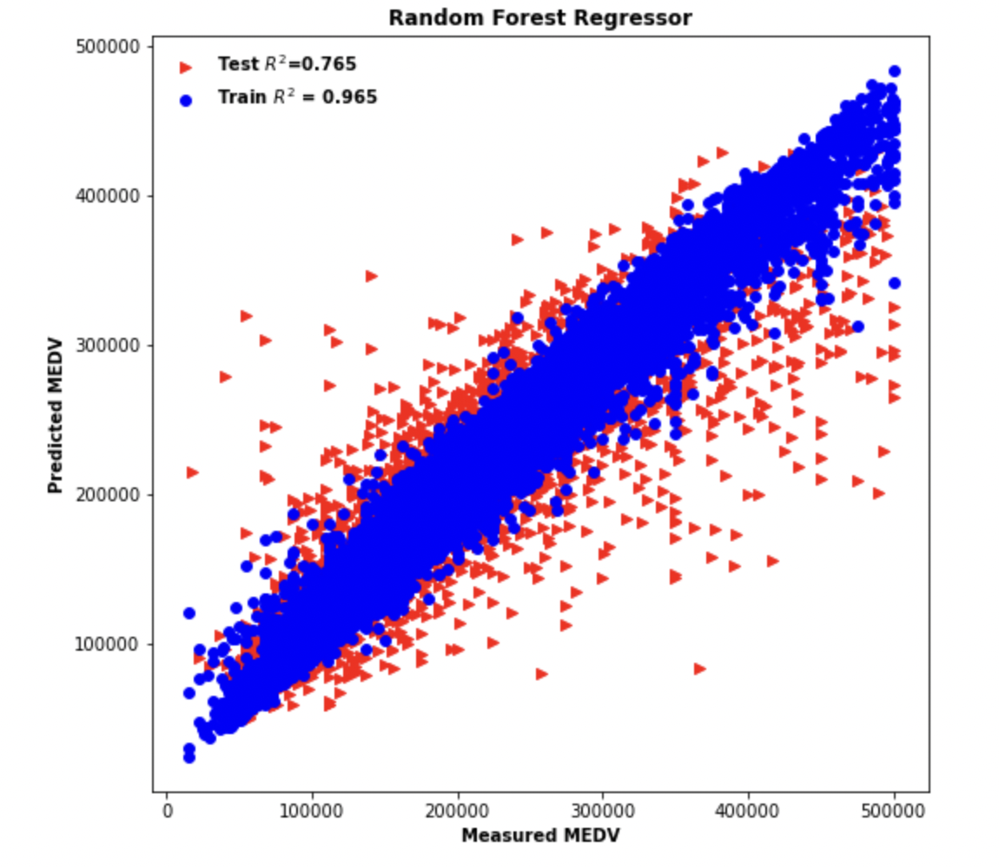
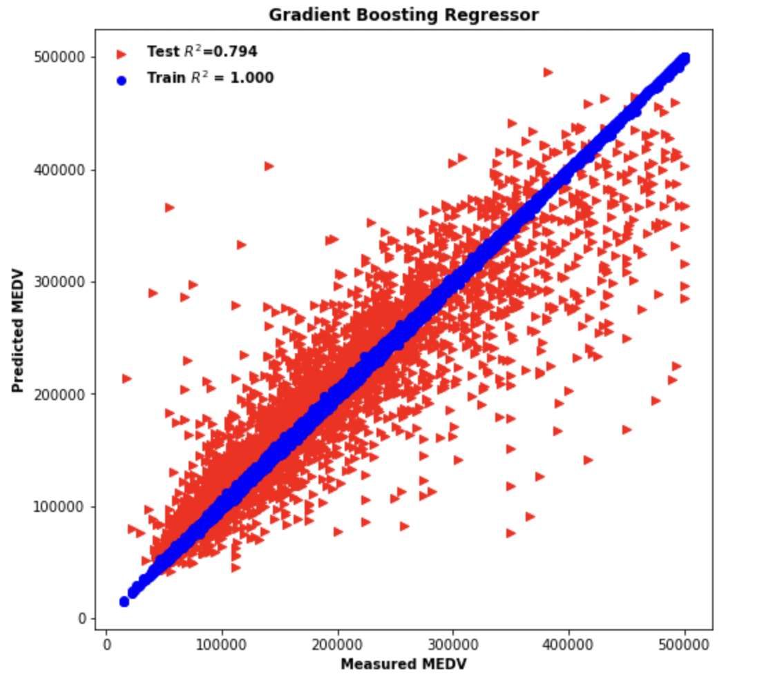
Tree-based models
Decision Tree Regression
Best Parameters for Grid Search
Parameter | Value
R-2 on Train Data set | 0.7631
R-2 on Test Data set | 0.6544
max_depth: 9
Random Forest Regression
bootstrap : False
max_depth: 30
max_features: ‘sqrt’
n_estimators: 30
Parameter | Value
R-2 on Train Data set | 0.9581
R-2 on Test Data set | 0.7736
Gradient Boosting
n_estimators : 500
max_depth: 10
max_features: ‘log2’
criterion: ‘squared_error’
Parameter | Value
R-2 on Train Data set | 0.9997
R-2 on Test Data set | 0.7985
Best model till now

Slide 14
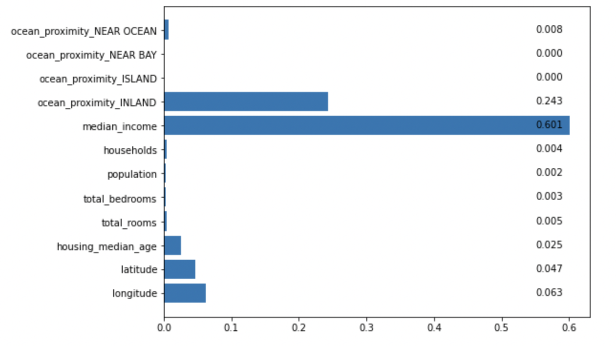
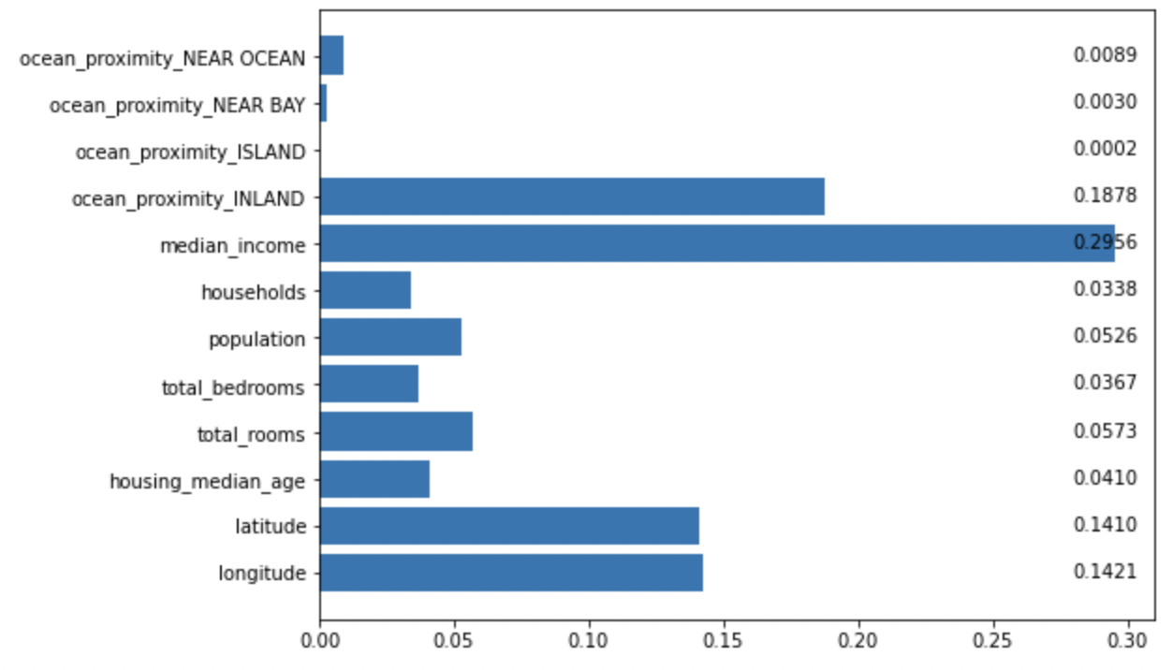
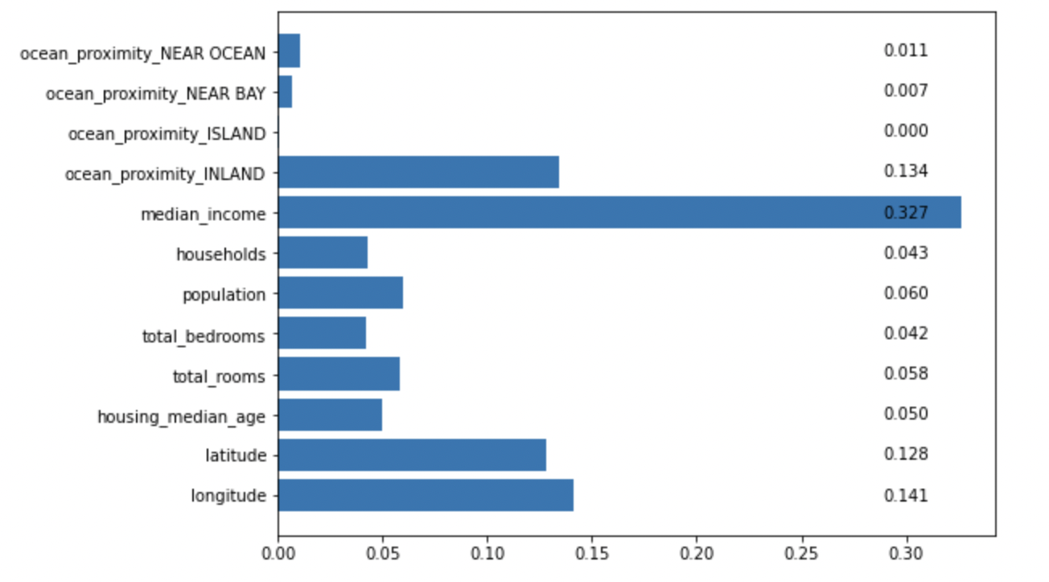
Feature importance – Tree based
Decision Tree
Gradient Boosting
Random Forest

Slide 15
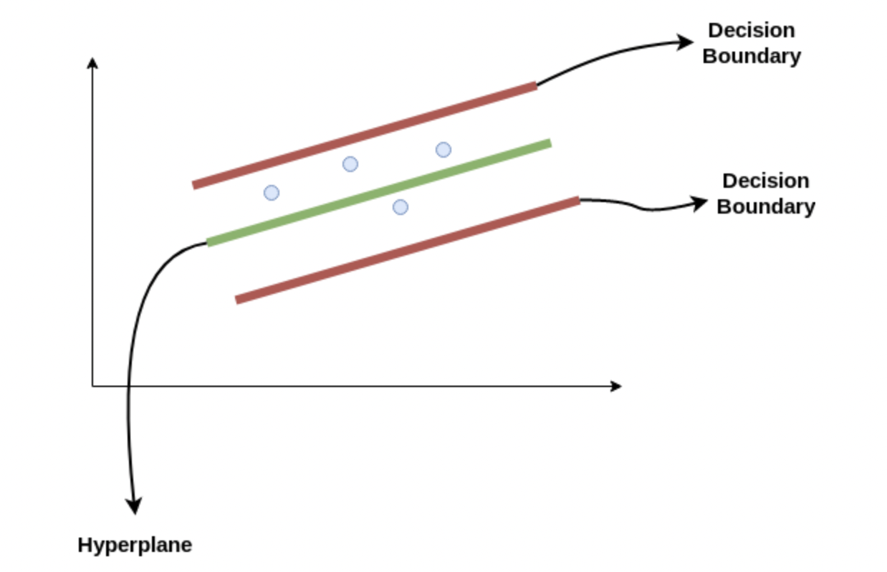
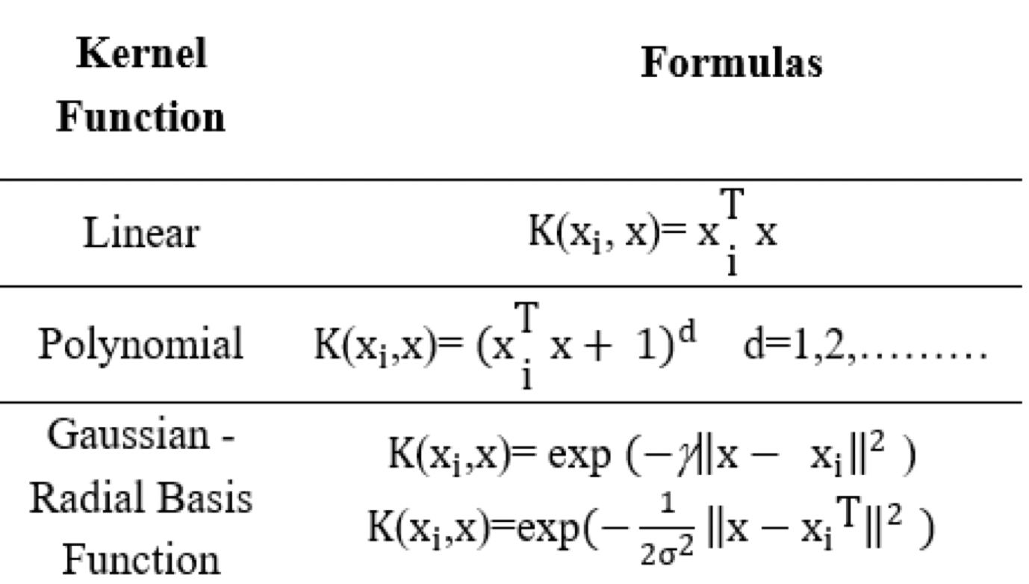
Support Vector Regression (SVR)
Support Vector Machines (SVM) are generally used for classification problems, where a hyperplane in n-dimension is used to classify the data points into classes.
SVM can also be used for regression, where a hyperplane in n-dimension (along with the decision boundaries) contain the maximum number of data points.
We will try to identify the equation of the plane which along with the decision boundary contains the maximum number of points.
Kernel Definition
Hyperparameter | Values | Purpose
C | numeric | Regularization Parameter. Penalty is L2 Determines the classification boundary
gamma | numeric | The gamma parameter defines how far the influence of a single training example reaches, with low values meaning ‘far’ and high values meaning ‘close’.
kernel | ’rbf’, ‘poly’, ’sigmoid’, ‘linear’ | functions to be used for the classification, used to create the different type of decision boundaries
NOTE:
GridSearchCV takes extremely long time to run for SVR therefore use HalvingGridSearchCV. It starts with limited resources (number of records) and then iteratively selects best candidates increasing resources
Parameter | Value
R-2 on Train Data set | 0.7981
R-2 on Test Data set | 0.7479
For SVR we would need to scale the Y variables as well as the hyperplane and decision boundaries are determining the distances

Slide 16
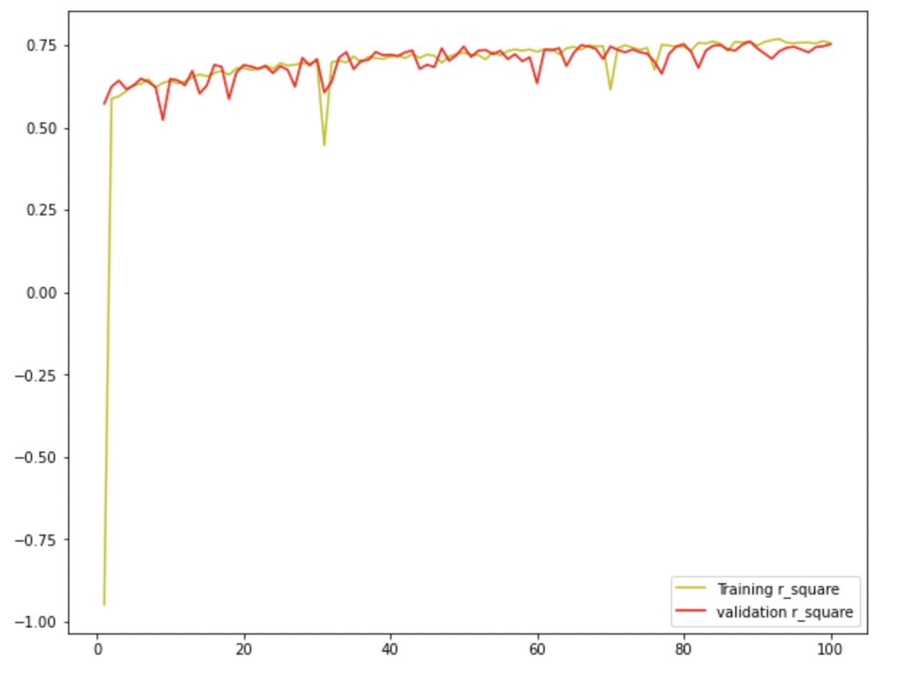
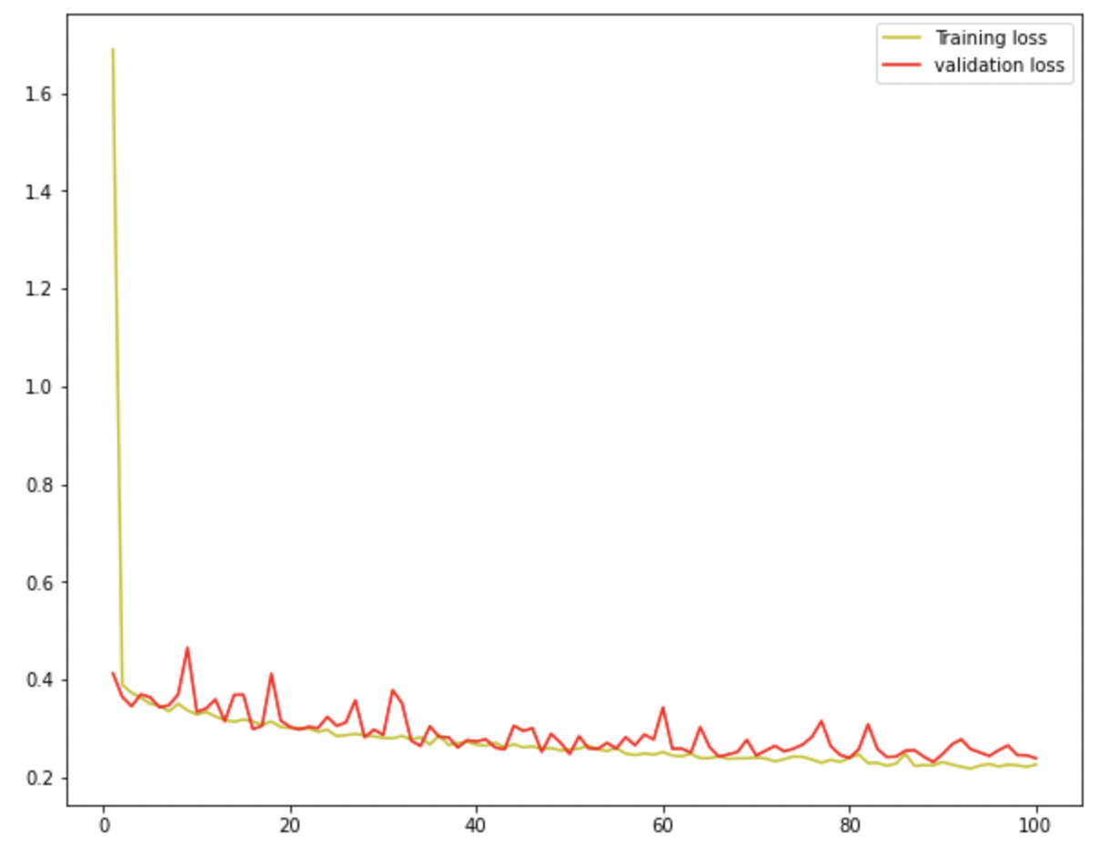
Artificial Neural Networks
Dropout: 20%
Dropout: 20%
Deep Layer 1
400 Neuron
sigmoid
Deep Layer 2
320 Neuron
tanh
Deep Layer 3
640 Neuron
relu
Output Layer
1 Neuron
linear
Input Layer
12 Inputs
Grid Search on ANN taking too long to run…
Parameter | Value
R-2 on Train Data set | 0.7885
R-2 on Test Data set | 0.7482
R2 Values for Epochs
Loss Function (MSE)

Slide 17
Results
Model | R-2 for Train | R-2 for Test | Root Mean Square Error
OLS | 0.6113 | 0.6187 | 61,809
OLS (Remove Multicollinearity) | 0.4930 | Not Computed | Not Computed
Lasso | 0.6113 | 0.6187 | 61,808
Ridge | 0.6113 | 0.6187 | 61,809
KNN Regression | 0.7513 | 0.6858 | 56,105
Decision Tree | 0.7631 | 0.6544 | 58,838
Random Forest | 0.9649 | 0.7649 | 48,536
Gradient Boosting | 0.9997 | 0.7945 | 45,376
Support Vector Regression | 0.7981 | 0.7479 | 50,256
ANN | 0.7885 | 0.7482 | 49,356
Best Model; Possible overfitting
Couldn’t run GridSearch

Slide 18
Thank You

Slide 19
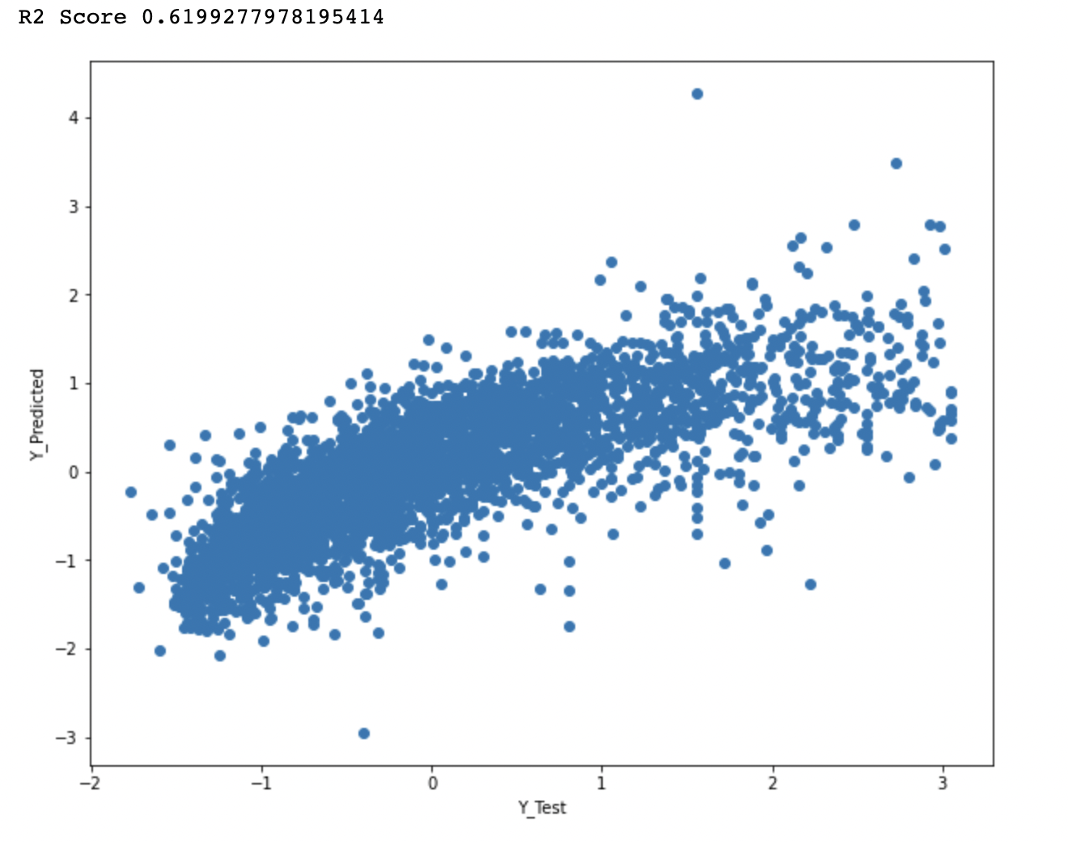
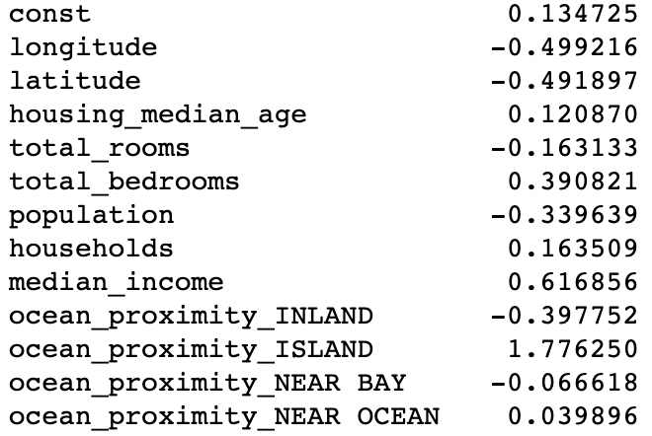
Output of the first model
Parameter | Value
R-2 on Test Data set | 0.6199
MSE (Train) | 60,556
MSE (Test) | 61,706
These variables are positively correlated with each other => should have same sign in the model.
This might be pointing towards multi-collinearity which we might need to solve for

Slide 20
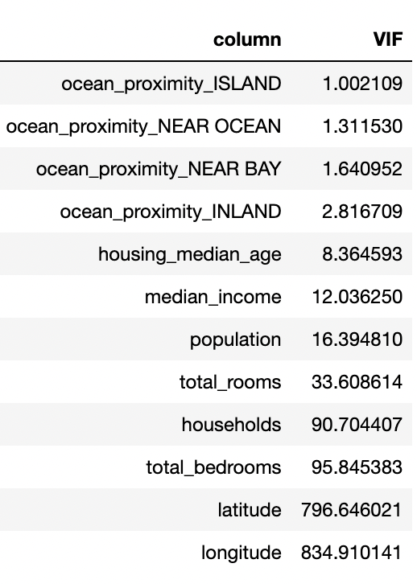
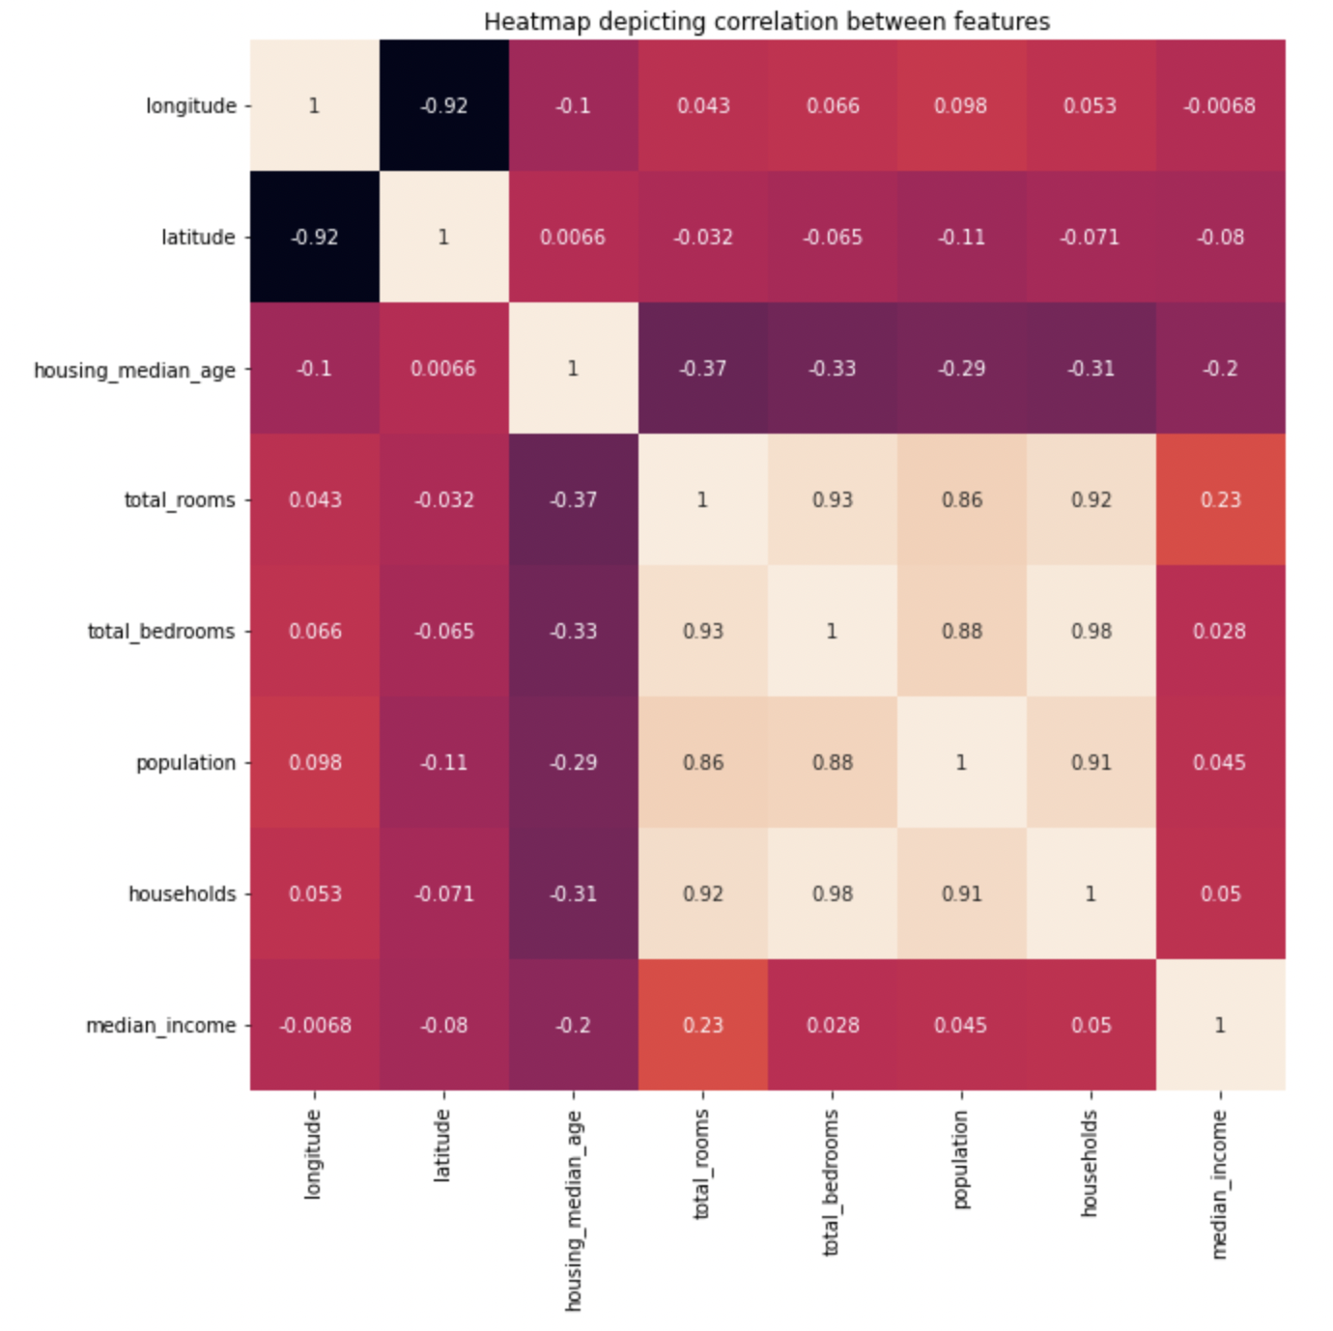
An attempt to remove Multi-collinearity (1/2)
CORRELATED VARIABLES:
Total rooms – Total Bedrooms, Population & Household
Latitude – Longitude
We use household (because of high correlation with others)
We use latitude (can choose either)
Parameters to be used:
ocean_proximity_ISLAND, ocean_proximity_NEAR OCEAN, ocean_proximity_INLAND, housing_median_age, median_income, households, latitude,
ocean_proximity_NEAR BAY

Slide 21
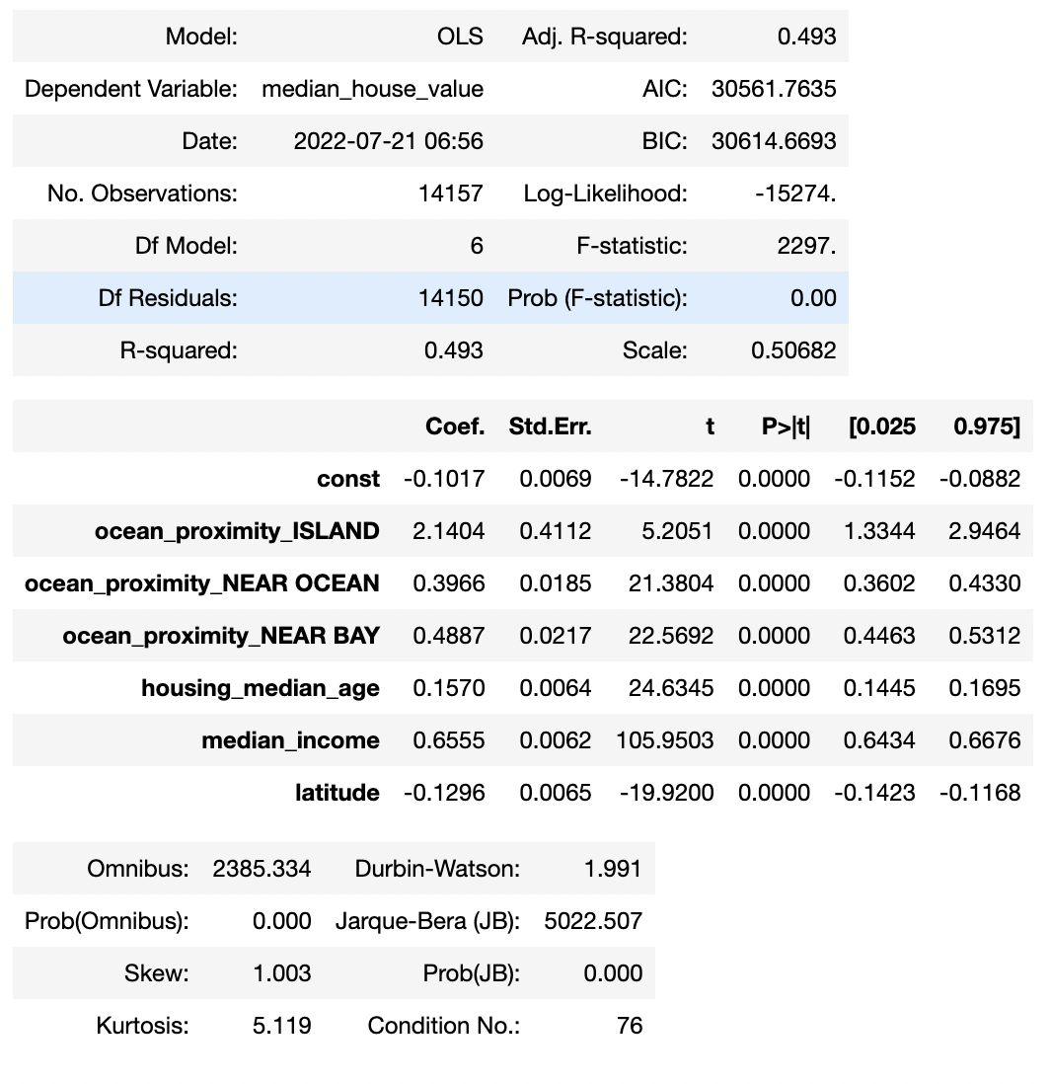
Attempt to remove multi-collinearity (2/2)
While the multi-collinearity related parameters have improved, the model performance has decreased (same happens even if you select some of the parameters).
Which, means the multi-collinearity is not reducing the model performance.
We will be using all the variables.
Outcome of Regression Model
Parameter | Value
R-2 on Test Data set | 0.6199
MSE (Train) | 60,556
MSE (Test) | 61,706

